Slide 1
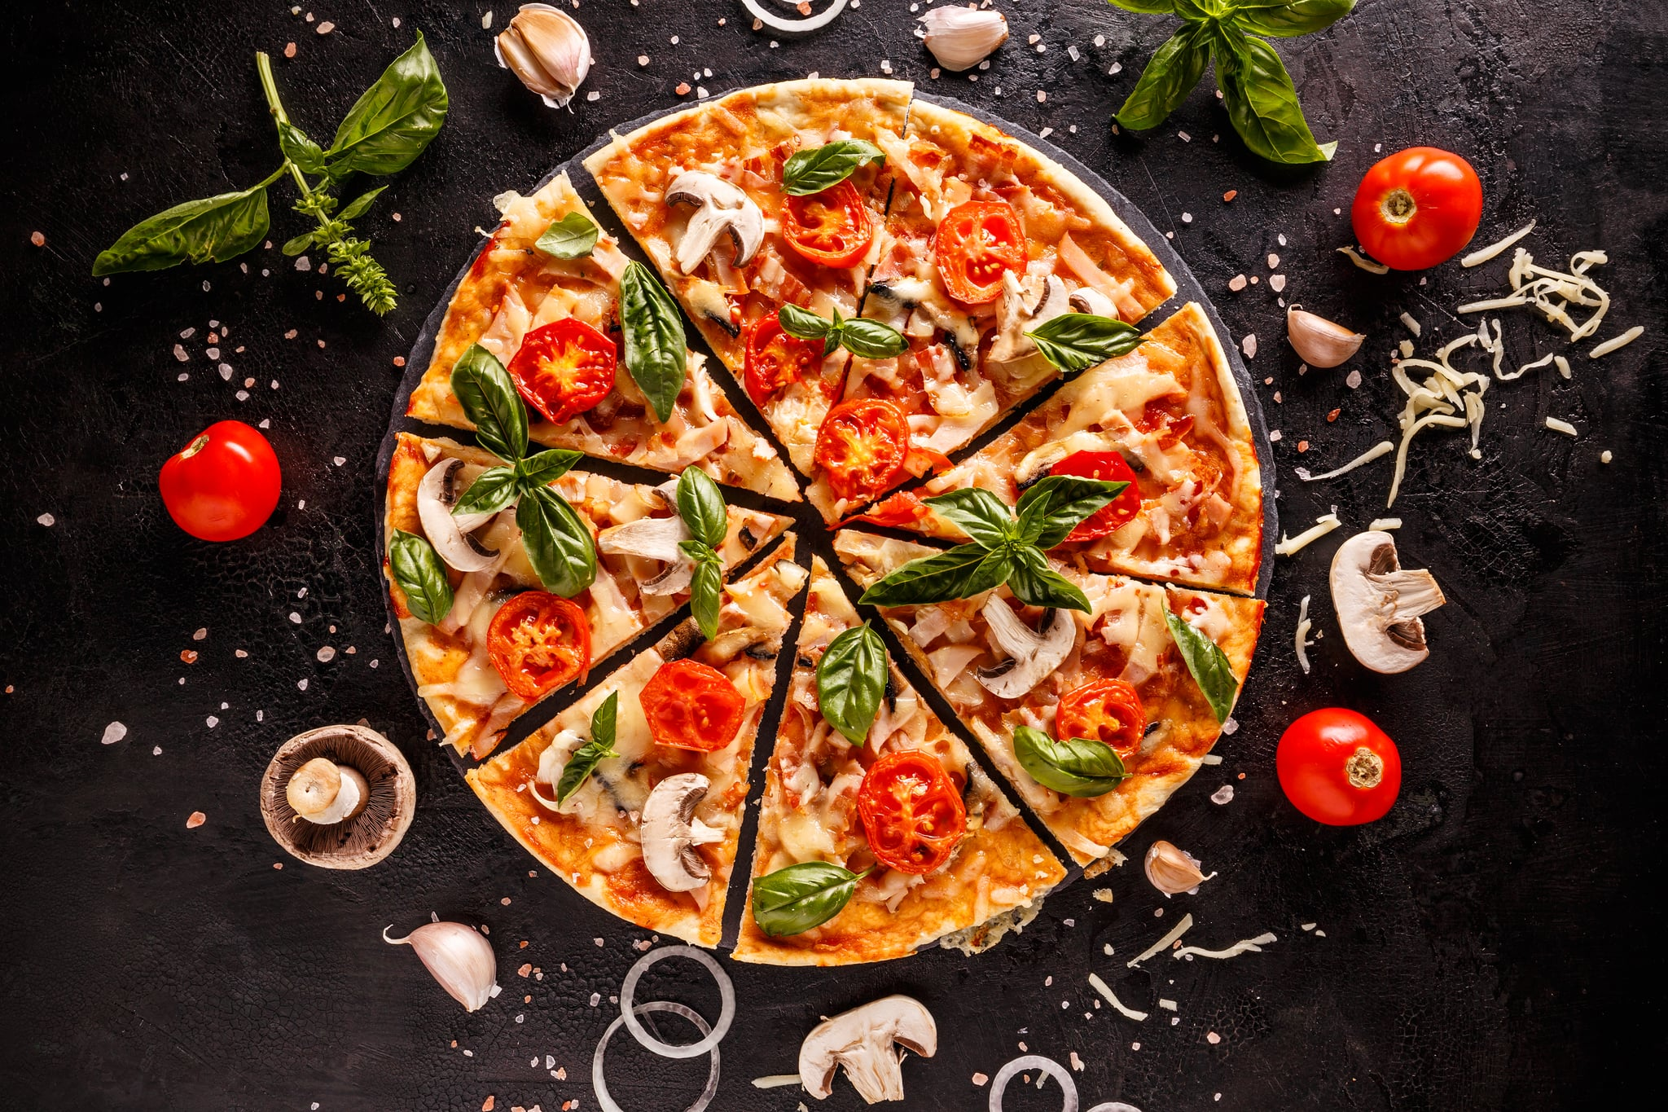

PIZZA SALES ANALYSIS
BY DIVYANSH BHATI

Slide 2
Table of Contents
Introduction
Process
Dashboard
Insights
Summary

Slide 3
Introduction
The Pizza Sales analysis aims to provide the comprehensive overview on the sales, trends & understanding the factors affecting the pizza sales.
It covers insights, that what are the most and least selling pizzas, at what time the sales are higher and what are the busiest days, how many pizzas are we making in peek hours, the average order value.

Slide 4
The Pizza Sales Dataset for Analysis includes:
order_id: Unique identifier for each order placed by a table.
order_details_id: Unique identifier for each pizza placed within each order.
pizza_id: Unique key identifier that ties the pizza ordered to its details, like size and price.
quantity: Quantity ordered for each pizza of the same type and size.
order_date: Date the order was placed.
order_time: Time the order was placed
unit_price: Price of the pizza in USD.
total_price: unit_price * quantity
pizza_size: Size of pizza.
pizza_ingredients: Ingredients used in pizza.
pizza_name: Name of the pizza as shown in the menu.
pizza_category: Category of pizza(eg classic, veggie, supreme, etc.)
hour: derived from order_time. Gives hour
day_of_week: Gives days(example Monday, Tuesday, etc.)
year: Gives year (2015).
month: Gives month (extracted from order_time column).

Slide 5
Process

Slide 6
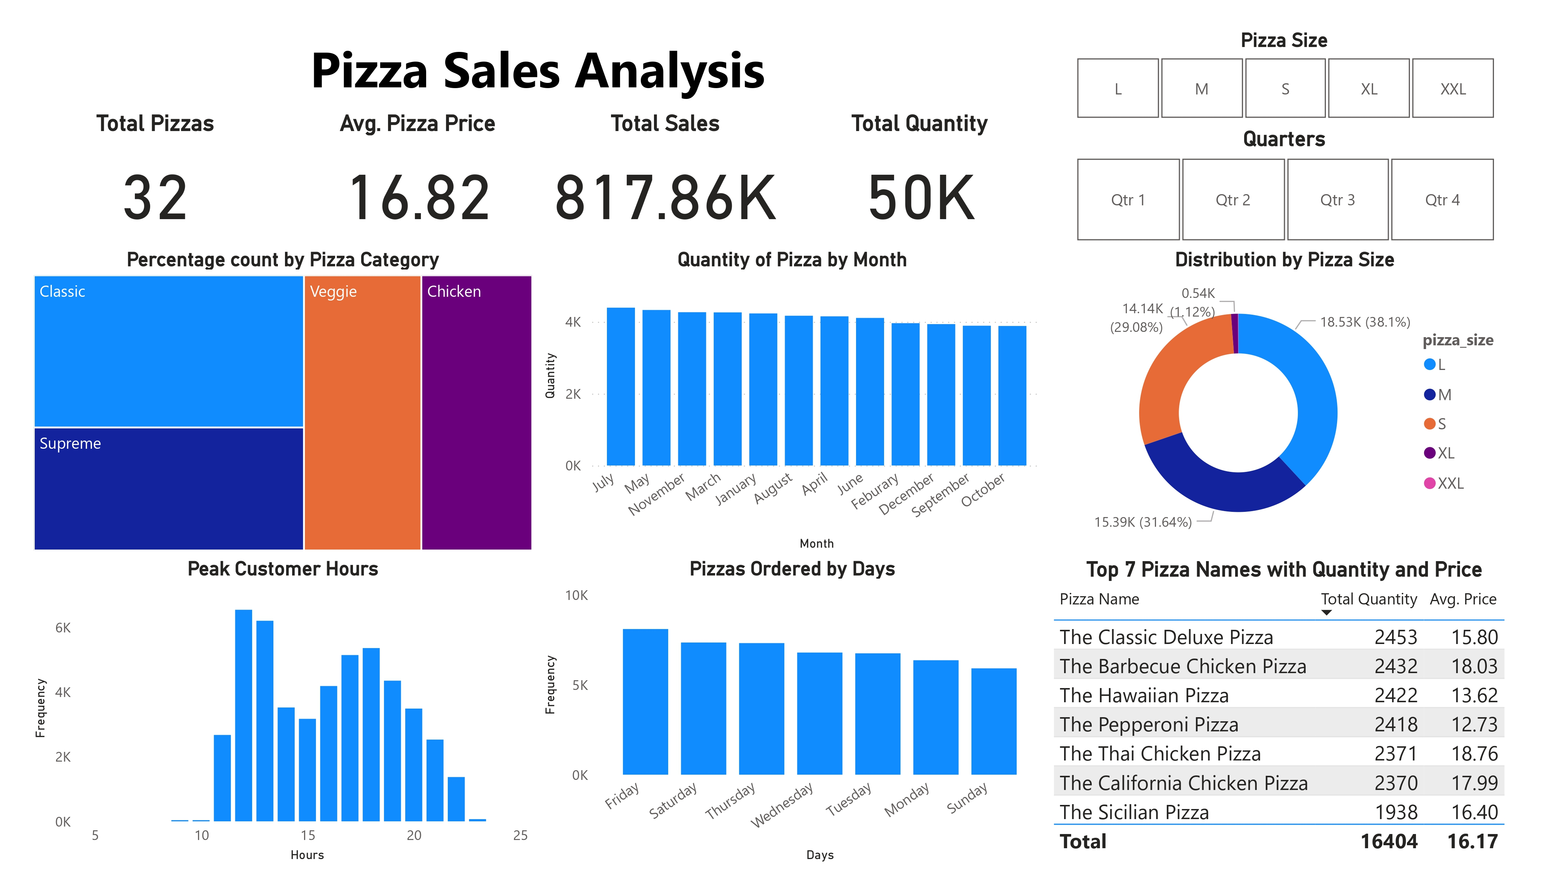

Slide 7
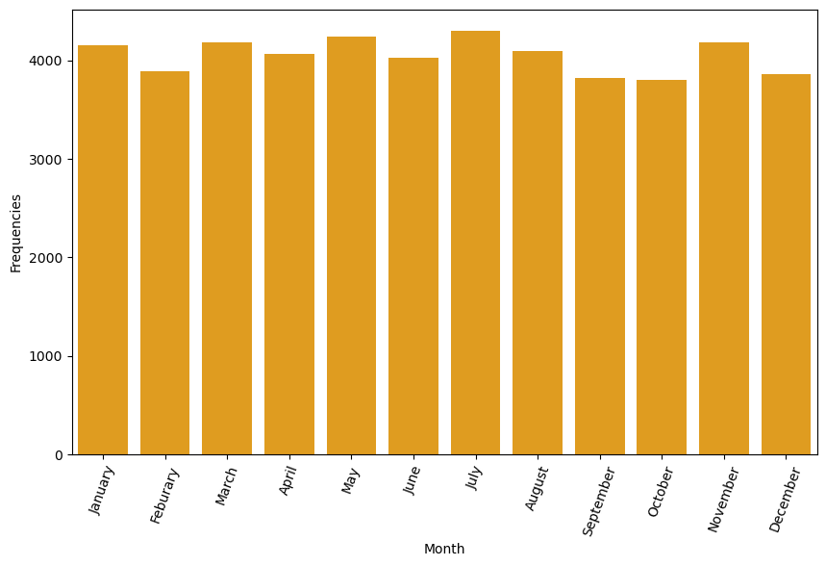
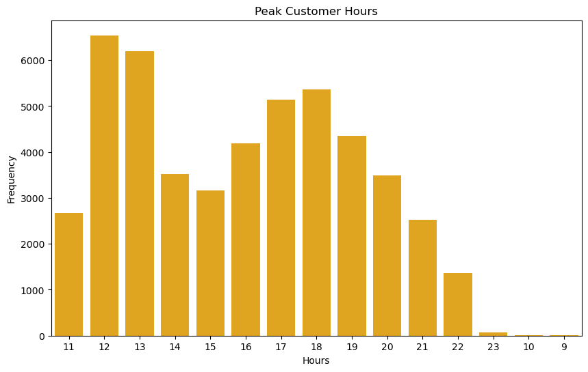
Insights
We can see that by categorizing the sales of pizzas by month, July leads the chart followed by May, November and March.
Although the store opens at 9AM but, at 12PM the pizza sales are the highest, 12 PM or Noon is the lunch time the sales are higher, at 1PM or 13 the sales declines till evening time.

Slide 8
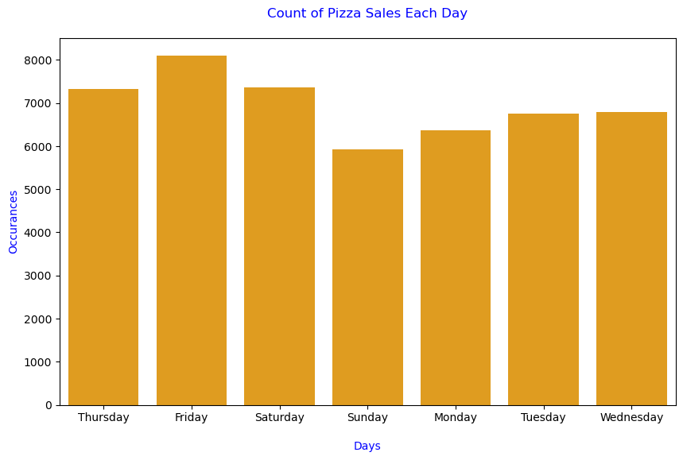
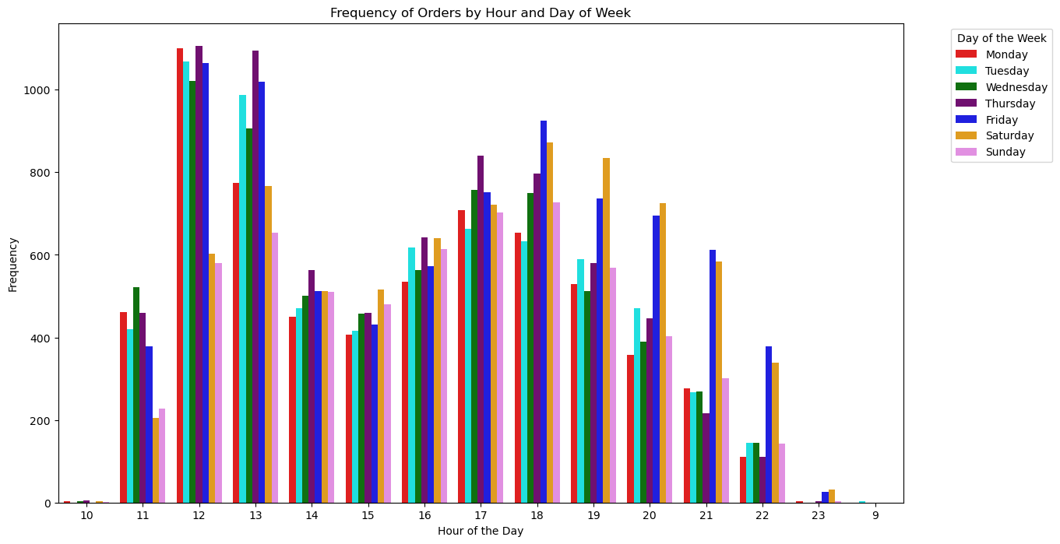
Insights
We can see that sales are highest on Fridays, then declining, then again rising from Sunday.
By combining the Hours and Days data and plotting, we can see that sales on Mondays and Thursdays at 12PM are highest. Most of our customers orders us at 12PM till 1PM.

Slide 9
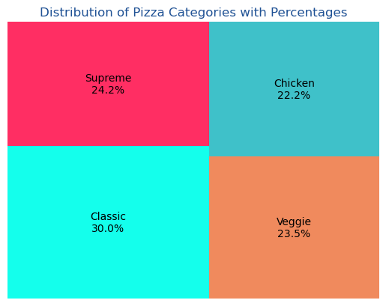
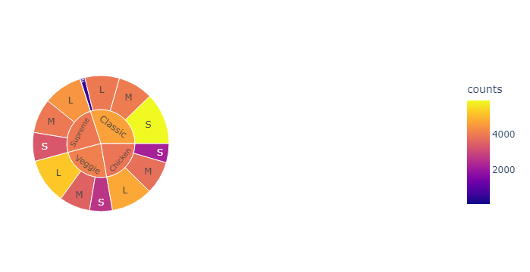
Insights
Classic pizza category has the highest order values followed by Supreme category.
The sunburst shows the further classification in pizza category with pizza size.
Categories with Sizes are as follows:
Classic with Small
Chicken with Large.
Veggie with Large
Supreme with Large

Slide 10
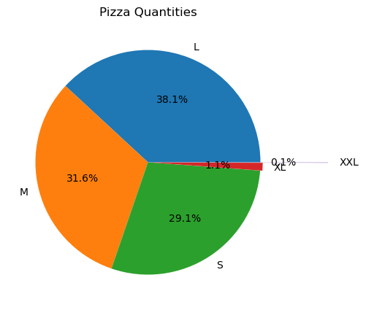
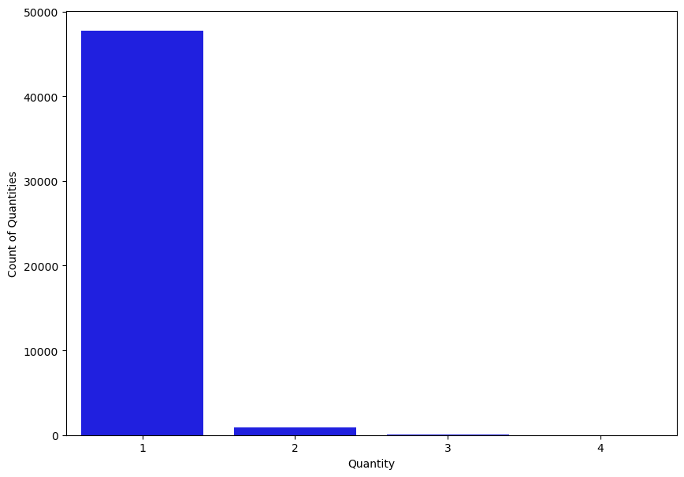
Insights
Large is the most ordered pizza size, XXL i.e. extra extra large is the least ordered pizza size.
Most of the customers orders only single quantity of pizzas. A very few of them orders more than 3 & 4 quantity of pizza.

Slide 11
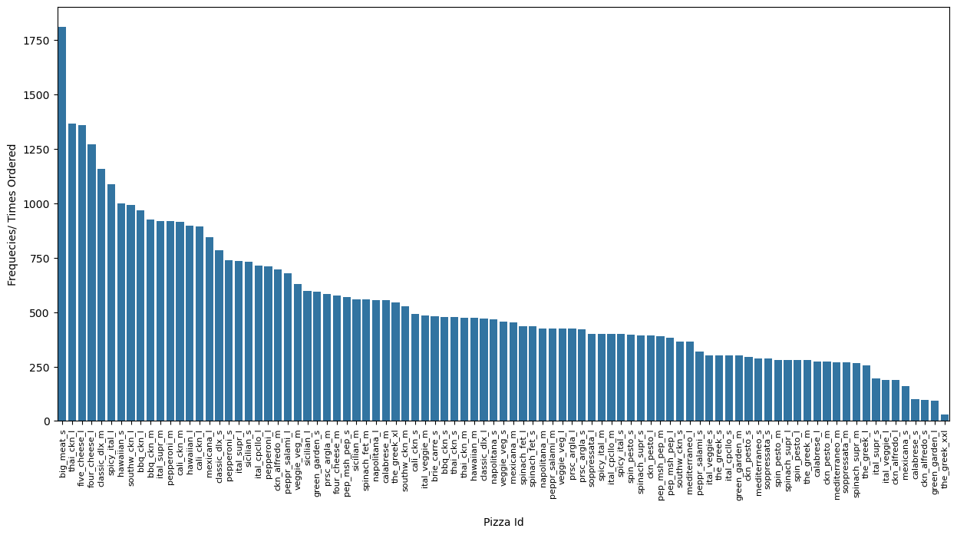
Insights
Big_meat_s is the most ordered type of pizza (pizza_id) and the_Greek_xxl is the least ordred pizza (pizza_id).

Slide 12
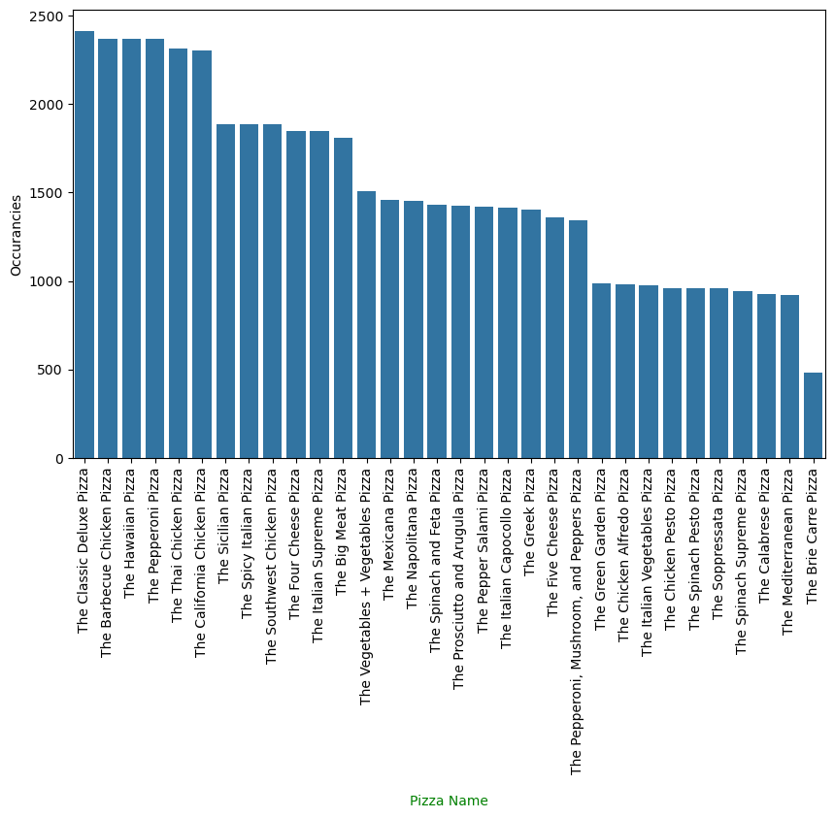
Insights
The classic deluxe pizza, the barbeque chicken, the hawain pizza and the pepperoni pizza are the most ordered pizzas(pizza_name).

Slide 13
Summary
There are total of 32 pizzas, average pizza price is $16.82.
$817.86K the total sales and total quantity of pizza sold 50,000.
Noon or 12PM has the most peak customer.
Fridays and Saturdays have most number of sales.
The Chicken delight pizza is the most ordered pizza (pizza_name).
Big_meat_s is the most ordered pizza by pizza_id and the_Greek_xxl is the lowest ordered pizza.
Large and Medium has more than 60% order share with 38.1% for Large and 31.6% for Medium size pizzas.
Most of the customers orders only a single quantity of pizza. A very few orders more than a single quantity at same time. A very few of them orders more than 3-4 quantity of pizza at same time.
Classic pizza category is the most ordered pizza category.
With furthermore analysis it is found that in Classic category the Small size is most ordered. Most of them has Large as most size.
July, May and November are the months where the pizza sales are highest. September and October the least.

